Slide 1
Prediction of Car Accident Severity
Yongyou Hu, PhD

Slide 2
Overview
Introduction
Feature selection and data Cleaning
Exploratory data analysis
Machine learning models
Results and discussion
Conclusion

Slide 3
Introduction
The Problem
Car accidents happen everyday and everywhere
High accident severity will involve injuries and even fatalities
Lack of a model to predict accident severity
The Solution
Extract insights from car accident data and build a prediction model to help people drive more safely

Slide 4
Feature Selection & Data Cleaning
Feature selection
'VEHCOUNT', 'SPEEDING', 'ADDRTYPE', 'WEATHER', 'COLLISIONTYPE', 'PERSONCOUNT', 'INCDTTM' were selected based on meaning of each feature
'INCDTTM' was translated into 'WEEKEND' and 'TIMEOFDAY'.
The following features were added with dummy ones:
"TIMEOFDAY": NIGHT, MORNING, AFTERNOON and EVENING
"ADDRTYPE": Alley, Block and Intersection
"COLLISIONTYPE": Angles, Cycles, Left Turn, Right Turn, Head on, Parked Car, Pedestrian, Rear Ended, Sidewipe and other

Slide 5
Feature Selection & Data Cleaning
Data cleaning
For simplicity, those data samples with missing values were deleted. After cleaning, the total data samples were reduced from 194673 to 187755.

Slide 6
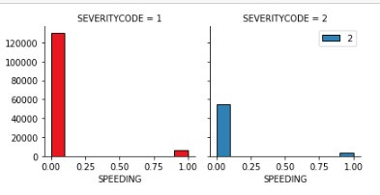
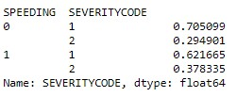
Exploratory Data Analysis
Relationship between SPEEDING and SEVERITY

Slide 7
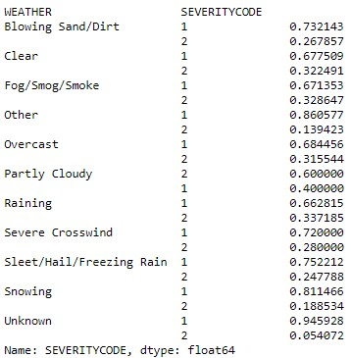
Exploratory Data Analysis
Relationship between WEATHER and SEVERITY

Slide 8
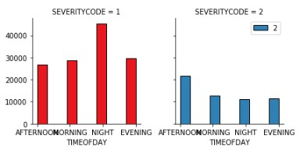
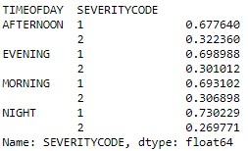
Exploratory Data Analysis
Relationship between TIMEOFDAY and SEVERITY

Slide 9
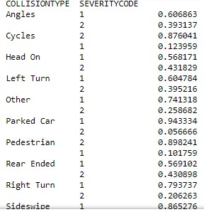
Exploratory Data Analysis
Relationship between COLLISIONTYPE and SEVERITY

Slide 10
Machine Learning Models
Three classification algorithms were investigated
Logistic Regression
The optimal regularization parameter, C was found to be 0.1 based on a few trials.
K-Nearest Neighbor (KNN)
The optimal neighbors, K was found to be 8 based on the max. accuracy
Support Vector Machines (SVM)
The optimal kernel was found to be radial basis function (rbf) based on results of all four kernels (linear, ploynomial, rbf and sigmoid)

Slide 11
Machine Learning Models
Model performance
Logistic Regression is the fastest and most accurate model
Algorithm Name | Jaccard | F1-Score | Log Loss
KNN | 0.730 | 0.705 | -
SVM | 0.748 | 0.687 | -
Logistic Regression | 0.755 | 0.715 | 0.485

Slide 12
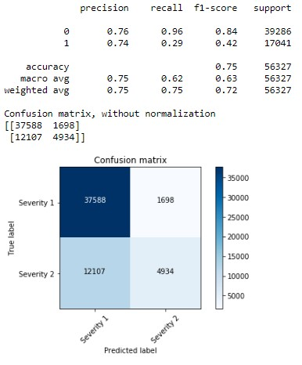
Machine Learning Models
Confusion Matrix of Logistic Regression Model with unbalanced labels

Slide 13
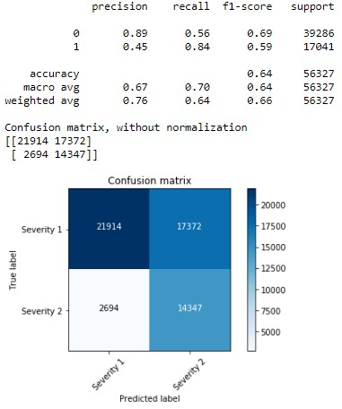
Machine Learning Models
Confusion Matrix of Logistic Regression Model with balanced labels

Slide 14
Results & Discussion
Logistic Regression Model is the best
Weather and road conditions barely affected the accident severities
Most accidents happened in the afternoon
Accidents involving pedestrians and cyclists will most likely be Severity 2
Drive more carefully at intersections and no speeding

Slide 15
Conclusion
Driver should avoid speeding and driving in afternoon if possible
This model will be helpful for drivers to decide if they should drive or not under certain conditions

